Slide 1
Online Retail Store
Data Analysis
Notes:
online retail store
review their data and provide insights that would be valuable to the CEO and CMO
he business has been performing well and the management wants to analyse what the major contributing factors are to the revenue so they can strategically plan for next year

Slide 2

Business Problem
analyze what the major contributing factors are to the revenue
seeking guidance into areas that are performing well
view different metrics based on the demographic information that is available in the data.
viewing the metrics from both an operations and marketing perspective.
Notes:
interested in viewing the metrics from both an operations and marketing perspective.
can keep a clear focus on what’s working.
Data clean:Create a check that the quantity should not be below 1 unit
Create a check that the Unit price should not be below $0

Slide 3
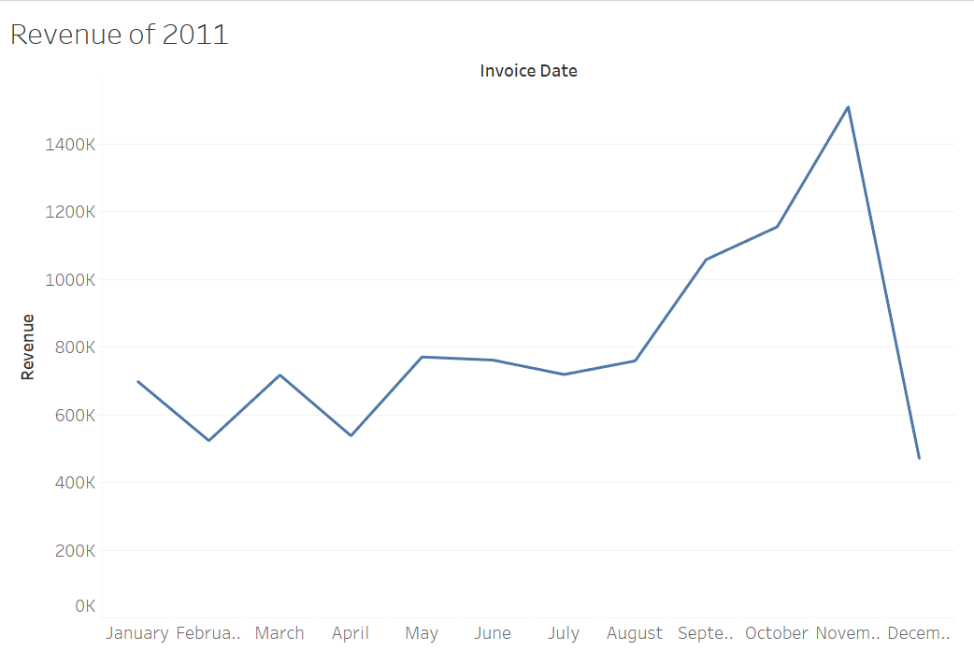
What is the monthly trend of revenue, which months have faced the biggest increase/decrease?
Notes:
view the time series of the revenue data for the year 2011 only. He would like to view granular data by looking into revenue for each month

Slide 4
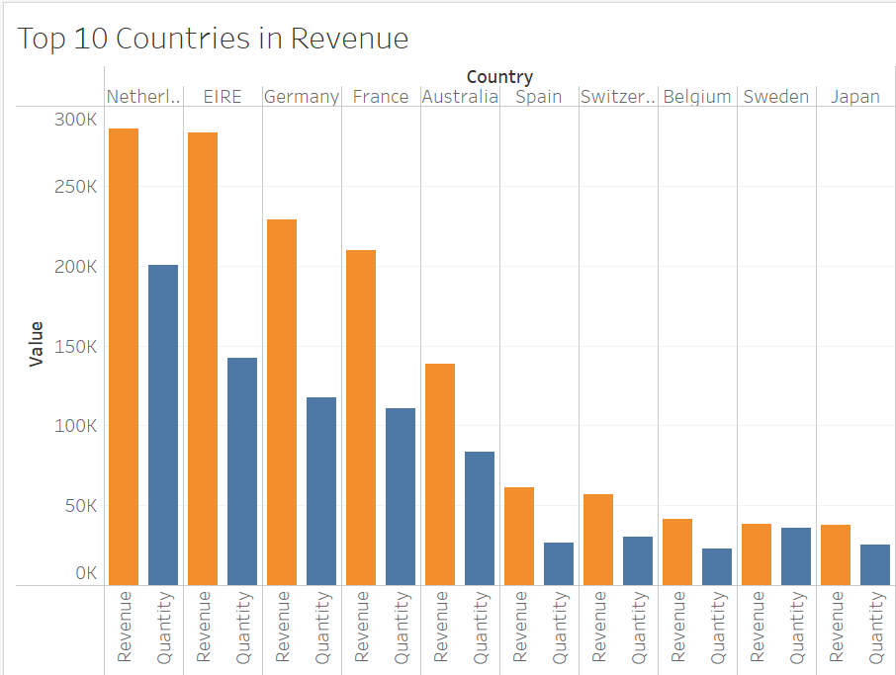
top 10 countries which are generating the highest revenue
Notes:
top 10 countries which are generating the highest revenue.
viewing the quantity sold along with the revenue generated.
not United Kingdom in this visual.

Slide 5
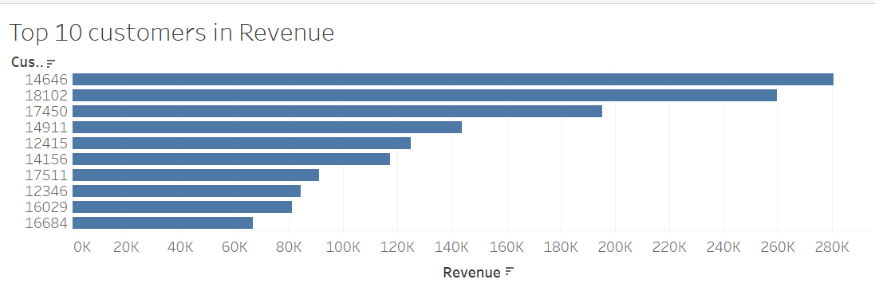
Who are the top customers and how much do they contribute to the total revenue
Notes:
to view the information on the top 10 customers by revenue
visual that shows the greatest revenue generating customer at the start and gradually declines to the lower revenue generating customers
ensure that they remain satisfied with their products

Slide 6
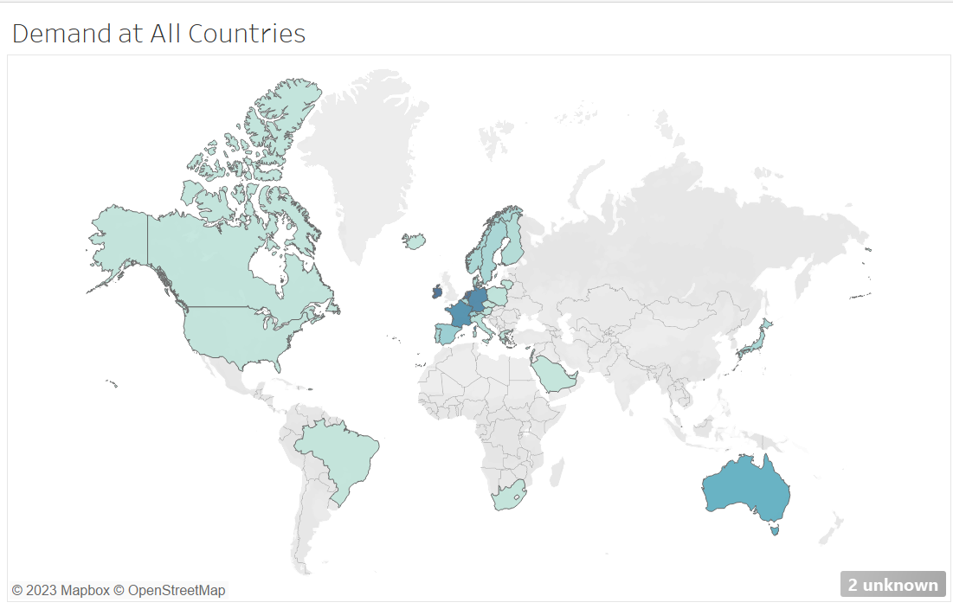
which regions have the greatest demand for their products?
Notes:
look at all countries and see which regions have the greatest demand for their products.
expansion strategy which will allow the company to target these areas and generate more business from these regions.

Slide 7
Thank You!

